Slide 1


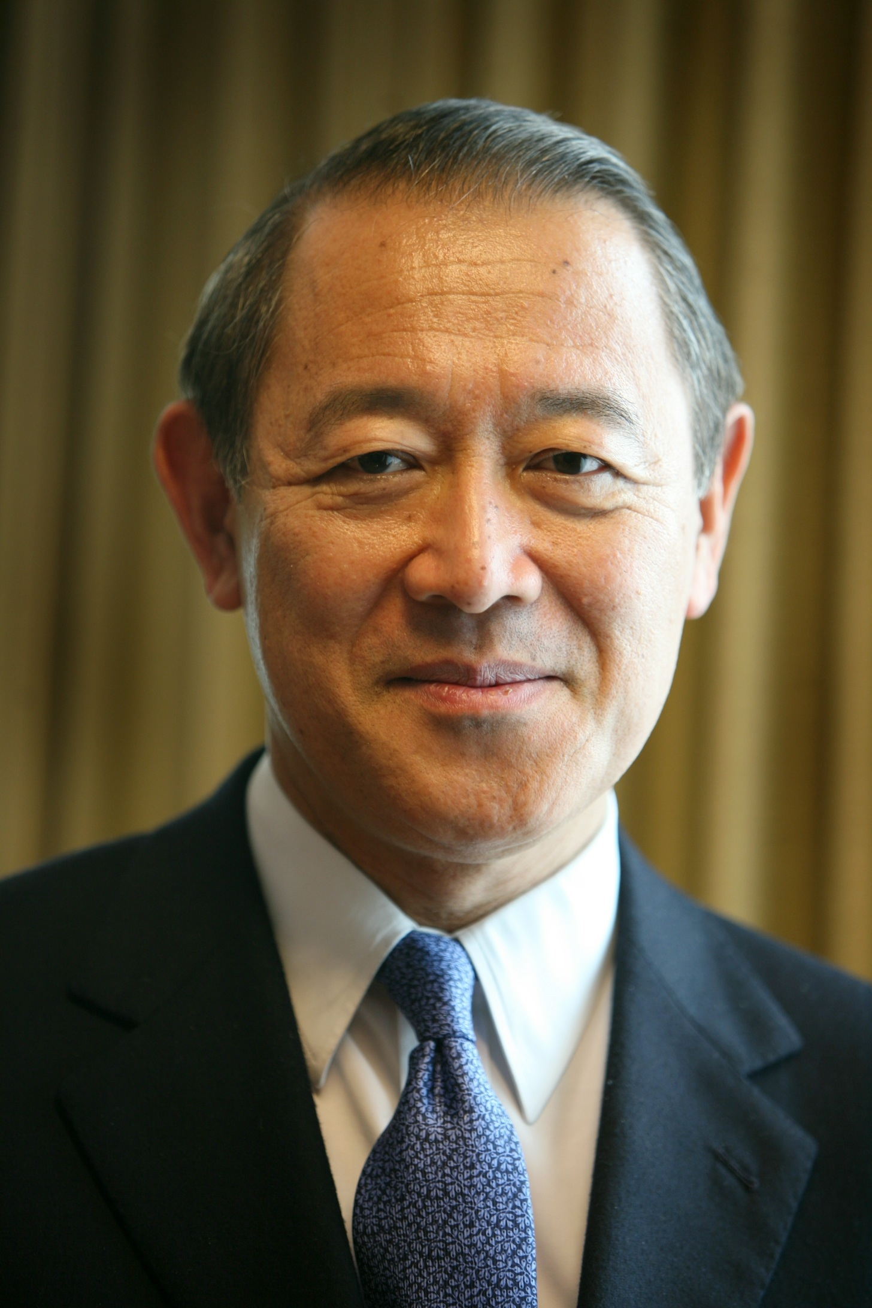
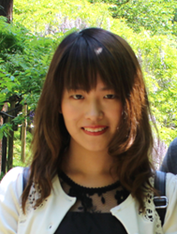
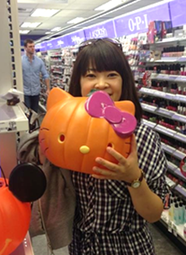
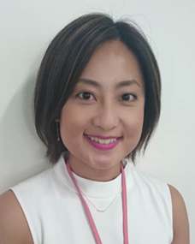
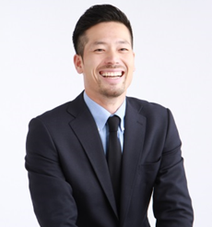

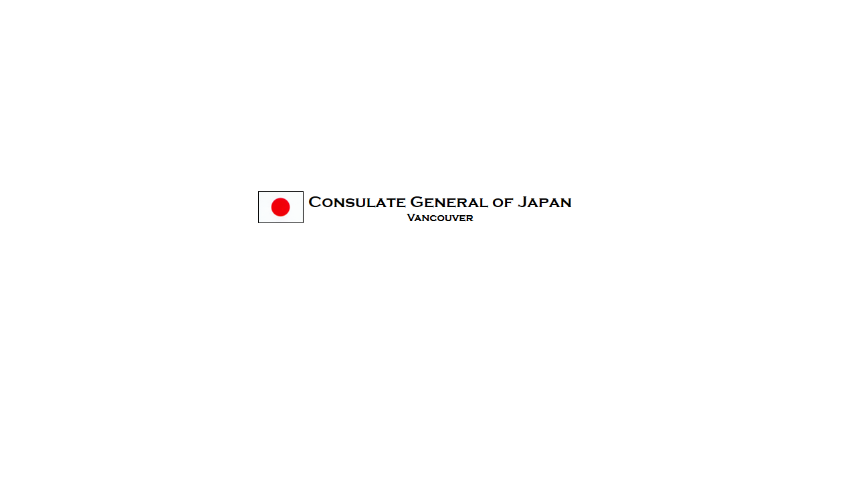
An Invitation to Join
Ambassador Ichiro Fujisaki
Former Ambassador of Japan
Join us for a rare and exciting opportunity to engage with Ambassador Ichiro Fujisaki and a panel of young experts from Japan in a stimulating dialogue on Japan-related issues. Led by Ambassador Fujisaki, the panel of four specialists working in diverse fields will discuss some of the major concerns facing Japan and the world including recovery from the Great East Japan Earthquake, energy, Japan’s technology, culture policy and economic policy.
Panel and Reception
Oct. 28 (Fri.) – 11 am
Sage Bistro – UBC
6331 Crescent Road. Vancouver
Application Required:
Check our FB for application
https://www.facebook.com/JapanCons.vancouver/
Followed with a Q & A session and a luncheon reception.
The presentation and discussion will be led by H.E., Ichiro Fujisaki, former Ambassador of Japan to the United States. While he was Deputy Minister for Foreign Affairs, Ambassador Fujisaki served as the chief negotiator in Japan-Canada vice-ministerial economic meetings. He was also responsible for Japan-Canada relations as Director-General of the North American Affairs Bureau at the Ministry of Foreign Affairs.
Ayano Maria HORIGUCHI: With a banking background former “Team Tohoku” volunteer from UBS shares her perspective on recovery from the earthquake and tsunami and the hopes of the younger generation.
Kanako KATAYAMA: A paralegal who formerly worked in the energy field talks about Japan’s efforts toward energy efficiency and cultural initiatives such as “Cool-biz” to reduce consumption.
Erina KIMIZU: From her experience in cosmetics marketing and product development (Shiseido and Bare Essentials), Ms. Kimizu shares how “Cool Japan” is being communicated in various ways and her experience in global marketing.
Katsuya YUZUKI: A business manager of a real estate and construction company talks about the real effects of “Abenomics”, on business and the Japanese economy.
CENTRE FOR
JAPANESE RESEARCH

